Slide 1
Woodland Public Schools
Facilities and Safety Report
For August 2016

Slide 2
FACILITIES REPORT
Summer Work
Numerous projects were completed over the summer that were driven by safety, existing work orders and needs of other departments. My team will continue to push forward in these areas, as we still have a ton of work to do here. (You eat an elephant one bite at a time.) Not only does this work protect our capital assets, but it also instills pride in our students and gives our community campuses they can be proud of. Some of the major work that has been completed includes:
1. Portables – WMS- siding and ramps were replaced and the old IT portable was removed. Five of the portables at the Middle School received new siding and paint. We will continue this activity at WPS over the next few months until weather stops us.
2. Fences for the schools – Six foot vinyl fences were installed at WPS, WMS and WIS. These fences were installed to better isolate the campuses from potential external hazards.
3. Painting – All of the schools received hundreds of gallon of paint internally and externally. Numerous areas also required framing and siding replacement, or other repairs as a result of weather damage from years of inattention. We have a lot of work to do here, still. Our priority this summer was to address the most damaged areas first. Moving forward we will place the buildings on a regular paint cycle to circumvent this issue.

Slide 3
FACILITIES REPORT
4. Roofing – After months of repair, the WMS mezzanine roof was completed in July. There was a substantial amount of damage under the roof that required structural engineering and follow on repairs. Many of the District roofs are showing distress from age and will require some level of repair in the near future; more on this topic to come.
5. Siding WPS – Numerous sheet of siding were repaired, replaced and painted on the parapet wall of the WPS. Additionally, 50 % of this wall was painted back to the original school colors. Ingrid picked the trim color to give the paint job its new pop of color.
6. Paving and seal coating – Paving, seal coating and crack repair were completed at WPS and WIS. This will be part of an ongoing maintenance plan to keep the blacktop surfaces from getting breached by water, and ultimately destroying them.
7. Hundreds of work orders were completed and we still have an impressive stack to go through. The balance will be prioritized and addressed on a case by case basis.

Slide 4
FACILITIES REPORT
Bottle Fill Stations
2 of the 4 bottle fill stations have been installed at the Primary and Middle schools as part of the Healthy Kids Grant. Installation of the last two will proceed over the next few weeks. I expect all installations to be completed by November.
Follow On Lead Testing
A more detailed lead testing strategy will continue over the next few months to strengthen our initial testing results. Samples were drawn over the summer, but additional direction was given by the Washington State Schools from the DOH, stating that the samples were not to be drawn until school is in progress, to better replicate “actual school conditions”. We are required to have our lead testing program in place, and sampling program completed by July 2017.
LED Lighting Upgrades
We will continue to retrofit existing lighting systems and convert them to LED in selected areas. The goal here is to, reduce electrical costs, reduce maintenance costs and improve lighting quality. There are three viable methods to do this.
LED lighting notes continued on next slide…

Slide 5
FACILITIES REPORT
LED Lighting cont.
1. Entire replacement of the fixture
2. Install LED lamps as a direct replacement for the fluorescent bulbs
3. Remove existing ballast and bulb and wire new lamps directly to the incoming power.
Option three presents the lowest cost with the highest benefit of electrical savings. Removing the lamp ballast and directly connecting the lamps to the incoming line voltage provides the maximum electrical savings and utilizes the existing fixture to reduce install cost. The PUD offers some great rebates for the retrofits, which makes the retrofit very appealing and offers a quick ROI.
Utilities
Starting in October, I will continue to track and chart utilities costs to better understand our usage and look for opportunities to reduce operating cost. Last year’s data will be overlaid with this year’s data to measure our performance in this area.

Slide 6
SAFETY
Accidents for the month
There were a total of 4 injuries in the month of August-2 students and 2 staff members. Both student accidents were in the weight room of the High School (prior to school actually starting), and ironically both were wrist fractures.
Staff Accidents/Incidents (10)
WPS – Employee had large splinter of wood driven under fingernail, removed surgically.
WMS – Employee strained back while carrying smart board.
WHS – Student fractured wrist while weightlifting.
WHS – Stress fracture wrist while weight lifting.
I will continue to provide detailed reports on safety throughout the year, and challenge each accident, incident or near miss, as an opportunity for enhancing our safety position. Each safety incident will be investigated and addressed. I will continue to send out safety memos and address each event as an opportunity for improvement.

Slide 7
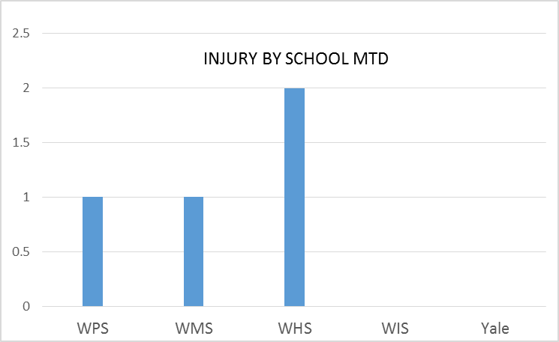
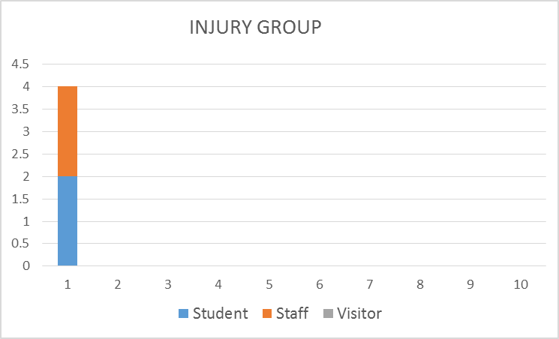
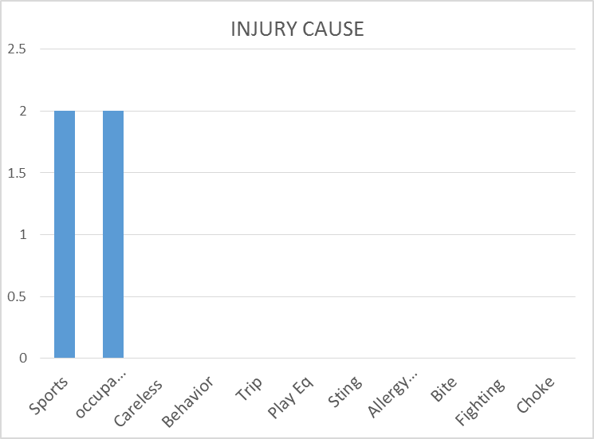
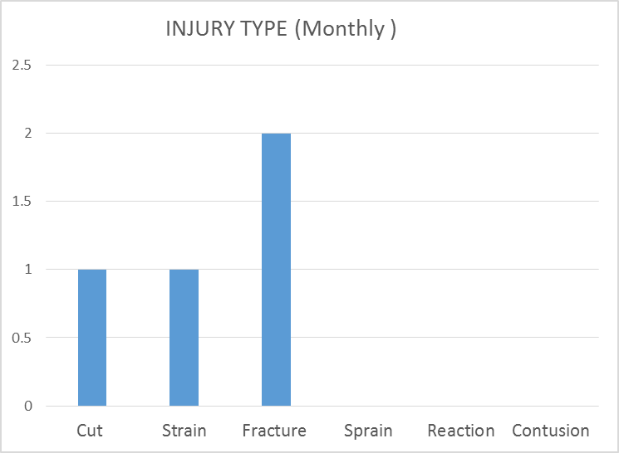
Safety Charts

